Slide 1
Developing Knowledge in Arduino
Phenomena

Slide 2
Review
Define a variable
int var = 5;
Data variable Value
Type Name

Slide 3

Today
RGB LED Project

Slide 4
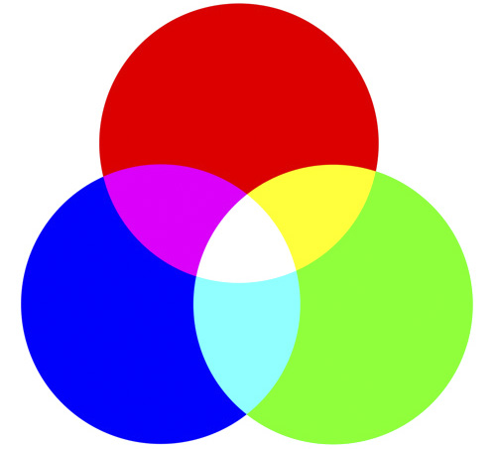
About RGB

Slide 5
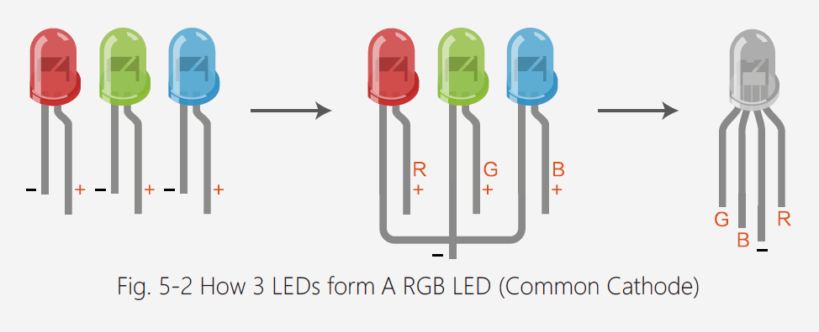
About RGB LED

Slide 6
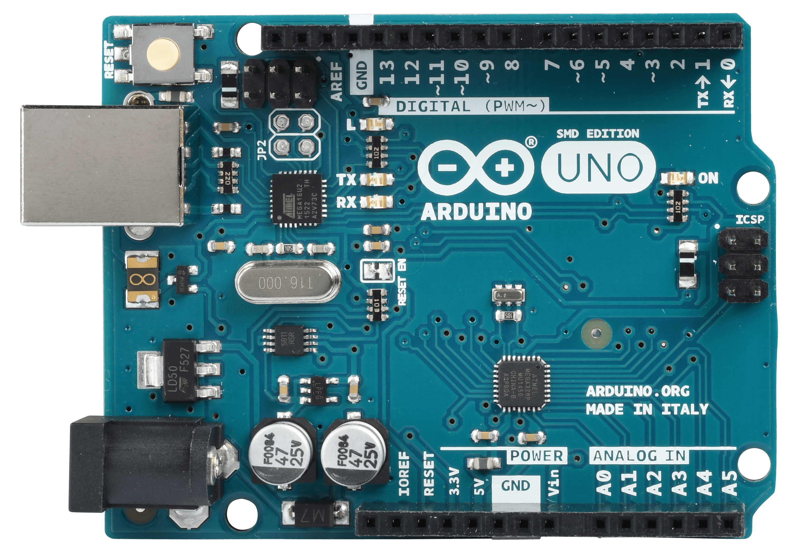
Pins to Connect: 9, 10, 11

Slide 7
GITHUB
Git is an open-source version control system. What does that mean?
When developers create something, for example an app, they make constant changes to the code, releasing new versions up to and after the first official release.
Version control systems keep these revisions straight, storing the modifications in a central repository. This allows developers to easily collaborate, as they can download a new version of the software, make changes, and upload the newest revision. Every developer can see these new changes, download them, and contribute.
An online drive for developers.

Slide 8
GITHUB
www.github.com/GNSPhenomena

Slide 9
Loops
A control flow statement for specifying iteration, which allows code to be executed repeatedly.
For Loop
While Loop
Do While Loop

Slide 10
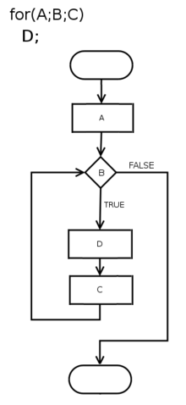
For Loop
for (initialization; condition; afterthought)
{
// code for the for-loop's body goes here.
}

Slide 11
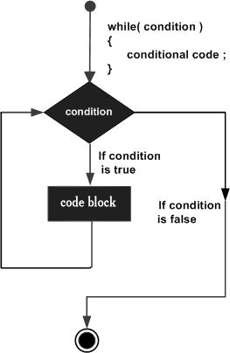
While Loop
while (condition)
{
// code for the for-loop's body goes here.
}

Slide 12
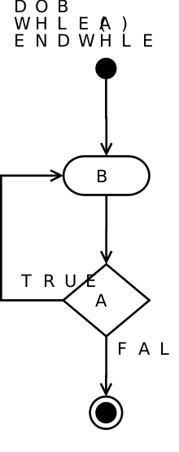
Do While Loop
Do
{
// code for the for-loop's body goes here.
} while (condition);

Slide 13
Function
A function is a group of statements that together perform a task. Every C program has at least one function, which is main(), and all the most trivial programs can define additional functions.
You can divide up your code into separate functions. How you divide up your code among different functions is up to you, but logically the division is such that each function performs a specific task.
A function declaration tells the compiler about a function's name, return type, and parameters. A function definition provides the actual body of the function.

Slide 14
Your Turn!

